Slide 1
19Z502 Microprocessors and Interfacing
Hardware Architecture
Dr.N.Arulanand
CSE, PSG CT

Slide 2
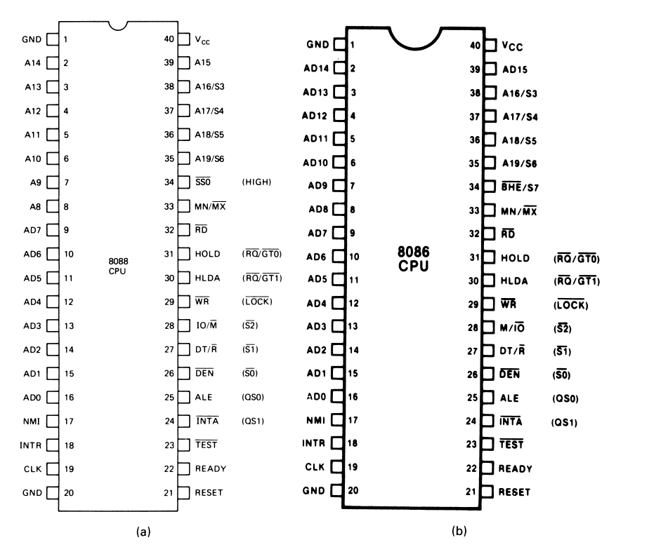

Slide 3
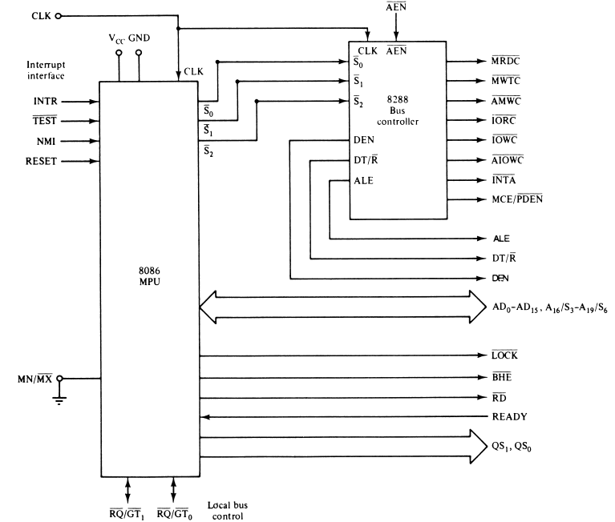
8086 Maximum Mode

Slide 4
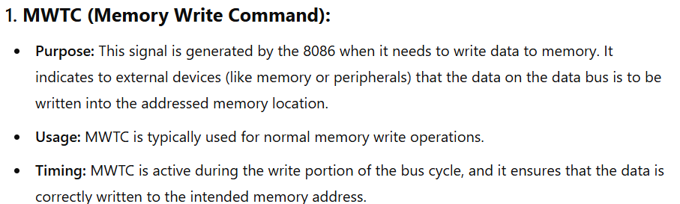
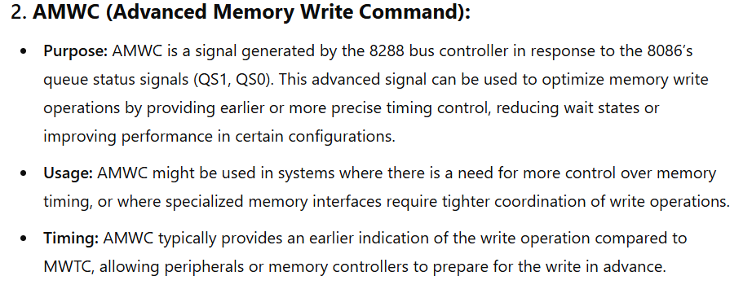
MWTC vs AMWC

Slide 5
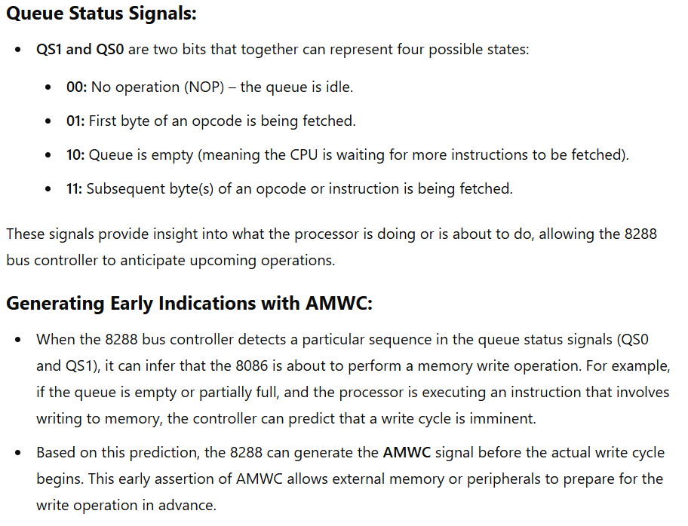

Slide 6
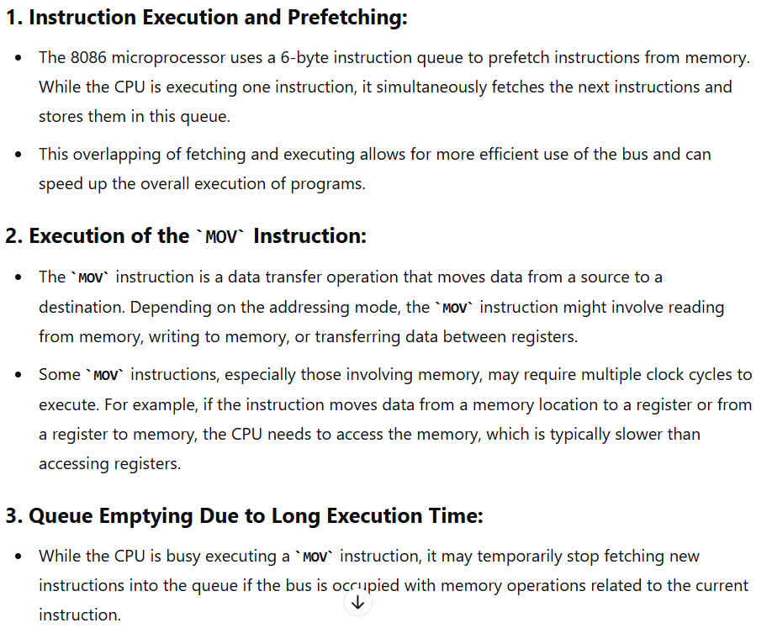

Slide 7
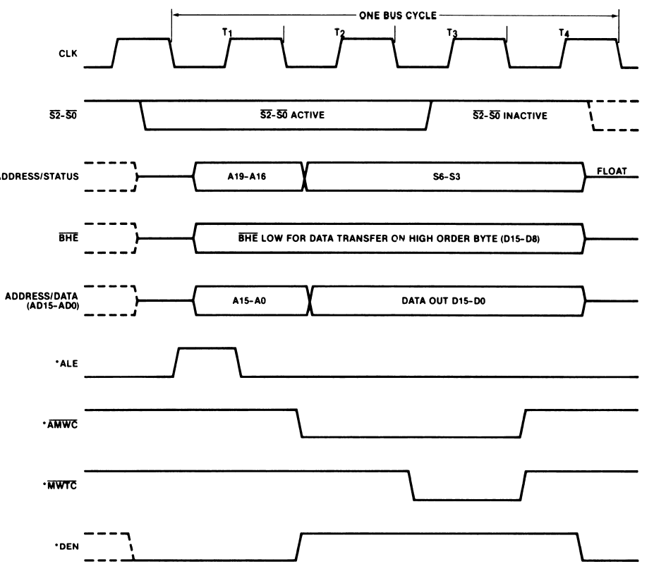
8086 Write Cycle

